Slide 1

UNIT V
CORE OF THE EMBEDDED SYSTEM

Slide 2
UNIT OUTCOME
At the end of this unit, student will be able to
Understand about the following concepts:
Microprocessors
Microcontrollers
GPP Vs ASIC
Basics of ARM PROCESSOR

Slide 3
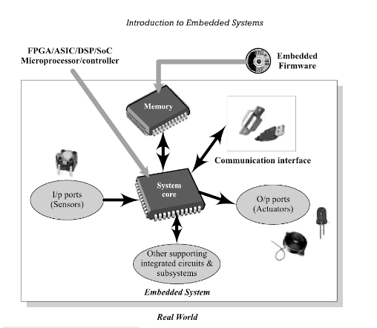
INTRODUCTION TO EMBEDDED SYSTEMS
An Embedded system is an electronic /elctromechanical system designed to perform a specific function and is a combination of both Hardware and Software.
It is unique and the hardware and firmware are highly specialized to the application domain.
It may or maynot contain an operating system for functioning.

Slide 4

INTRODUCTION TO EMBEDDED SYSTEMS
Purpose of Embedded Systems
Data Collection/ Storage/Representation
Data Communication
Data processing, Monitoring
Control Application specific user interface.
Applications of Embedded Systems
Consumer electronics
Household appliances
Home automation
Banking and retail
Measurement and Instrumentation
Health care
Automotive industry.

Slide 5

Characteristics of an Embedded Systems
A system which is a combination of special purpose hardware and embedded OS for executing a specific set of applications.
May or maynot contain an operating system for functioning.
The firmware of an ES is pre-programmed and it is non alterable by the end user.
Application specific requirements are the key deciding factors.
Highly tailored to take advantage of the power saving modes supported by the hardware and the OS.
Execution behavior is deterministic for certain types of ES like “Hard Real Time Systems”.
The response time requirement is crtical for some critical systems.

Slide 6

Classification of Embedded System
Multiple Classifications based on different criteria:
Based on Generation
    First Generation
    Second Generation
    Third Generation
    Fourth Generation
Based on complexity and Performance
    Small Scale Embedded systems
    Medium Scale Embedded systems
    Large Scale Embedded systems
Based on Deterministic Behaviour
    Deterministic/Non Deterministic
    Real time ES: Hard/ Soft

Slide 7

Core of the Embedded Systems
Embedded Systems are built around a central Core
General Purpose and Domain Specific Processors
    Microprocessors
    Microcontrollers
    Digital Signal processors
Application Specific Integrated Circuits (ASIC's)
Programmable Logic Devices (PLD's
Commercial Off the Shelf Components (COTS)

Slide 8
Microprocessor Vs Microcontroller
    Microprocessor
A silicon chip representing CPU, performing ALU operations according to pre defined set of instructions.
It is a dependent unit.
General purpose design and operation.
Doesn't contain a built in I/O port.
Targeted for high end market where performance is important.
Limited power saving options.
    Microcontroller
A highly integrated chip that contains Scratch pad RAM, special and general purpose register arrays, on chip ROM/FLASH memory for program storage, timer and interrupt controller units and dedicated I/O ports.
It is independent unit.
Application oriented or domain specific.
Contains multiple built in I/O ports.
Targeted for Embedded market.
Includes lot of power saving features.

Slide 9
Digital Signal Processor
Powerful special purpose 8/16/32 bit microprocessor designed specifically to meet the computational demands and power constraints of different application's.
2 to 3 times faster than GPP in signal processing application's.
It implements algorithms in hardware which speeds up the execution.
A typical DSP incorporates the following units:
    Program Memory: storing program required by DSP.
    Data Memory: Storing temporary variables and data /signal to be processed.
    Computational Engine: Performs the signal processing accordance with the stored program memory.
    I/O unit: Acts as an interface between the outside world and DSP( capturing signals and delivering processed signals).
Ex: Audio video signal processing, telecommunication and Multimedia Application, real time calculations like FFT, DFT, SOP etc.,

Slide 10
General Purpose Processor Vs
Application Specific Instruction Set Processor
      GPP
Designed for general Computational Tasks.
Ex: laptop, Desktop
It contains ALU and Control Unit.
High volume of production / low cost per unit.
        ASIP
The processors contains architecture and instruction set optimised to specific domain/ application requirements.
Ex: SoC, DSP's used in automotive, Telecom, media applications etc.,
It incorporates a processor and on chip peripherals demanded by the application requirement, program and data memory.
It fills the architectural spectrum between GPP and ASIC's.

Slide 11
Application Specific Integrated Circuits (ASIC's)
It is a microchip deigned to perform a specific or unique application.
Used as a replacement for conventional general purpose logic chips.
It integrates several functions into a single chip and consumes very small area in the total system.
It can be pre-fabricated for a special application or it can be custom fabricated by using the components from a re-usable building block library of components .
Non Recurring Engineering Charge (NRE) : It is a non refundable initial investment for the fabrication of ASIC's and it is a one time investment.
Application Specific Standard Product (ASSP): If the Non Recurring Engineering Charges is borne by a third party and the Application Specific Integrated Circuit (ASIC) is made openly available in the market, the ASIC is reffered as ASSP.
Ex: ADE7760 Energy Metre ASIC developed by Analog Devices for Energy Metreing applications.

Slide 12

Programmable Logic Devices (PLD's)
PLD's can be re- configured to perform any number of functions at any time.
Features of PLD's
It has a wide range of logic capacity, features, speed and voltage characteristics
The designers uses inexpensive software tools to quickly develop, simulate and test their designs.
There are no NRE cost and the final design is completed fastly.
PLD's are based on re-writable memory technology.
Two major types of PLD's are
    CPLD's : offer smaller amount of logic up to about 10,000 gates, offer very predictable timing characteristics suitable for critical control applications. Ex: Xilinx Coolrunner.
    FPGA's: offer highest amount of logic density, the most features and the highest performance. Ex: Xilinx VirtexTM.

Slide 13

Commercial Off -the -Shelf Components (COTS)
COTS provides easy integartion and interoperability with existing system components.
It can be developed around GPP, Domain specific Processor , ASIC or PLDs
Advantage:
Readily available in market, cheap and a developer can cut down his/her development time to a great extent.
Disadvantage:
Due to rapid change in technology, if the COTS component is withdrawn by the manufacturer/ or discontinue the production , will adversely affect a commercial manufacturer of ES which make use of the specific COTS product.

Slide 14
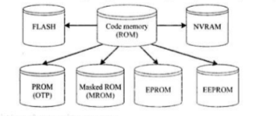
Memory
Memory is required for holding data temporarily during certain operations.
On chip memory: built in memory
Off chip memory: external memory connected with the controller/ processor for storing controller algorithm.
Program Storage Memory
Also called as code storage memory of an ES stores the program instructions.
It retains its contents even after the power to it is turned off.( non-volatile storage memory)

Slide 15

Program Storage Memory (ROM)- Classification
Depends on fabrication, erasing and programming technique, ROM is divided as follows:
A) Masked ROM (MROM)
    One time Programmable device
    Uses hardwired technology to store the data
    This is low cost for high volume of production.
    It is a good candidate for storing the embedded firmware for low cost embedded device.
    Limitation is that its inability to modify the device firmware against firmware upgrades.
B) Programmable Read Only memory (PROM/OTP)
    The end user is responsible for programming this memory
    This memory consists of polysilicon or nichrome wires functionally viewed as fuses
    Fuses which are not blowned /burned represents logic “1” whereas fuses which are blowned/ burned represents logic “0”
    OTP isused in commercial production of ES

Slide 16
Program Storage Memory (ROM)-Classification (contd...)
C) Erasable Programmable Read Only Memory ( EPROM)
    EPROM gives flexibility to re-program the same chip.
    It stores the bit information by charging the floating gate of an FET to a high voltage.
    It contains a quartz crystal window , which is exposed to UV rays rays for 20 to 30 minutes, the entire memory will be erased.
    Limitation is Erasing the memory using UV rays is tedious and time consuming process.
D) Electrically Erasable Programmable Read Only Memory ( EEPROM)
    The information contained in this memory can be erased and re-programmed in-circuit using electrical signals at register/Byte level.
    It provides greater flexibility for system design.
    Limitation is its capacity (only a few kilobytes).

Slide 17
Program Storage Memory (ROM)-Classification (contd...)
E) FLASH
    Latest ROM technology which combines the re-progarmmability of EEPROM and high capacity of standard ROMs.
    It is organized as sectors /pages.
    It stores the information in array of floating gate of an MOSFET.
    Each sector is erased before re-programming and it is done at sector level /page level without affecting sector/page.
    The typical erasable capacity is 1000cycles.
    Ex: W27C512 from WINDBOND (64 KB FLASH memory)
F) NVRAM ( Non volatile RAM)
    It is a RAM with battery backup.
    The lifespan of NVRAM is around 10 years
    Ex: DS1644 from Maxim/Dallas (32 KB NVRAM)

Slide 18
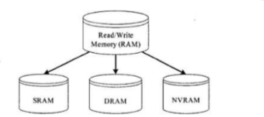
Read- Write Memory/ Random Access Memory (RAM)
RAM is the data or working memory of controller/ processor wher it can read from it and write to it.
It is volatile in nature
It is a direct access memory
Categories:
    Static RAM (SRAM)
    Dynamic RAM (DRAM)
    Non-volatile RAM (NVRAM)

Slide 19
Read- Write Memory/ Random Access Memory (RAM) - Classification
A) Static RAM (SRAM)
    It is the fastest form of RAM available (Resistive networking and Switching capabilities).
    It is made up of flip-flops and stores data in the form of voltage.
    It is realised using six transitors (MOSFET) out of which four is for building the latch part of memory cell and two for controlling the access.
    The major limitation of SRAM are low capacity and high cost.
B) Dynamic RAM
It stores the data in the form of charge
Advantage: high density and low cost
Disadvantage: Since it is stored as charge , it will get leaked off with
time, so refreshing is needed.
Special circuits called DRAM controllers are used for refreshing the operation.

Slide 20
Difference between SRAM and DRAM
SRAM
Made up of 6 CMOS Transistors (MOSFET)
Doesn't require refreshing
Low capacity
Fast in operation. Typical access time is 10ns
DRAM
Made up of a MOSFET and a capacitor
Require refreshing
High Capacity
Less expensive
Slow in operation. Typical access time is 60ns
Write Operation is faster tahn read operation

Slide 21
Read- Write Memory/ Random Access Memory (RAM)- Classification contd...
C) NVRAM ( Non volatile RAM)
    It is a RAM with battery backup.
    It contains static RAM based memory
    The lifespan of NVRAM is around 10 years
    Ex: DS1744 from Maxim/Dallas (32 KB NVRAM)
D) Memory according to the Type of Interface
Parallel Interface: Parallel data lines for an 8 bit processor/controller will be connected to the memory (memory size is in terms of kilobytes).
Serial Interface: I2C :2 line serial interface (used for data storage memory like EEPROM, memory size is in terms of kilobits) .
Ex: Atmel Corporations AT24C512 (512 K bits/ 2 wire interface).
Serial Peripheral Interface (SPI) : 2+n line interface where n stands for the total number of SPI bus devices in the system.
Single wire interconnection.

Slide 22
Sensors and Actuators
Sensors
A sensor is a transducer device that converts energy from one form to another for any measurement or control purpose.
Actuators
An actuator is a form of transducer device (mechanical or electrical) which converts signals to corresponding physical motion. It is an output device.

Slide 23
I/O Subsystem
The I/O subsystem of the embedded system facilitates the interaction of the embedded system with the external world.
    Light Emitting Diode (LED)
    7 Segment LED display
    Optocoupler
    Stepper Motor
    Relay
    Piezo Buzzer
    Push Button Switch
    Keyboard
    Programmable Peripheral Interface (PPI)

Slide 24
Communication Interface
Device/ Board level communication Interface ( Onboard Communication Interface)
    The communication channel which interconnects the various components within an embedded product
    Ex: Serial Interface like I2C, Spi, UART, 1-Wire & parallel bus interface
Product level Communication Interface (External Communication Interface)
    Responsible for data transfer between the embedded system and other devices or modules.
    It can be wired media , wireless media , serial or parallel interface
    Ex: IR, Bluetooth, Wi- Fi, RS232c, USB, Ethernet etc

Slide 25
Onboard communication Interfaces
Inter Integrated Circuit (I2C)
    It is a synchronous bi-directional half duplex two wire serial interface bus.
    It provides an easy way of connection between a microprocessor/ microcontroller system and the peripheral chips in television sets.
    It comprise of two bus lines:
        Serial Clock- SCL: Responsible for generating synchronisation clock pulses
        Serial Data – SDA : Responsible for transmitting the serial data across devices.
    It supports multimasters on the same bus
    It supports three different data rates
        Standard Mode: ( Data rate upto 100Kbps)
        Fast Mode: ( Data rate upto 400Kbps)
        High Speed Mode: ( Data rate upto 3.4Mbps)

Slide 26
Onboard communication Interfaces contd...
It is a shared bus system. The devices connected to it can act as Master or Slave.
Master: Responsible for controlling the communication by initiating/terminating data transfer, sending data and generating synchronisation clock pulses.
Slave : waits for the commands from the master and respond upon the receiving commands.
Master and slave device can act as either transmitter or receiver.
The synchronisation clock signal is generated by the Master device , regardless the master is acting as transmitter or receiver.

Slide 27
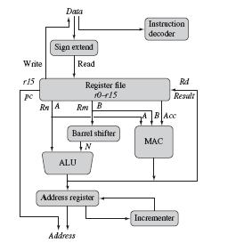
ARM PROCESSOR FUNDAMENTALS

Slide 28
Data flow model
Data enters the processor core through data bus
Instruction decoder translates instructions before they are executed.
Data items are placed in register file-storage bank made of 32- bit registers
Sign extend converts signed 8-bit and 16-bit numbers to 32 bit values
Two source registers-Rn and Rm Single destination register Rd
Source operands are read from register file using internal buses A and B
ALU takes the register values Rn and Rm and computes the result
Barrel shifter computes the result for any number of shifts within a clock cycle .
This is achieved as it is combinational logic (not sequential)
ex:ADD R3,R2,LSL#4
Multiply-Accumulate Circuit is used to perform both multiply and add
Ex : Matrix addition and multiplication
Load and store instructions use the ALU to generate an address to be held in the address register and broadcast on the Address bus

Slide 29
REGISTERS
Stack Pointer- stores the head of the stack in the current processor mode
Link register- core puts the return address when it calls a subroutine
Program counter- contains the address o the next instruction to be fetched by the processor
In ARM state the registers R0 – R15 are orthogonal.
Any instruction that you can apply to R0 can equally well apply to other registers

Slide 30
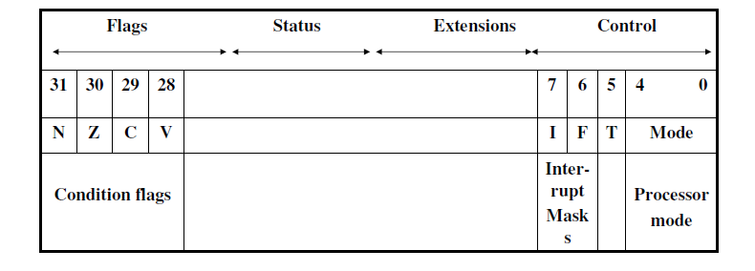
Current Program Status Register (CPSR)
32-bit register
contains the present status of an internal operation
ARM uses CPSR to monitor and control internal operations.
CPSR is a dedicated 32-bit register and resides in the register file.
A generic program status register

Slide 31
Current Program Status Register (CPSR) contd...
PROCESSOR MODES
The processor mode determines which registers are active and the access rights to the CPSR bregister itself.
Privileged mode-allows full read write access to CPSR
    Abort
    fast interrupt request
    Interrupt request
    Supervisor
    System
    Undefined
Non –Privileged mode
read access to control field to CRSP
read-write access to conditional flags
User

Slide 32
Current Program Status Register (CPSR) contd...
PROCESSOR MODES
The ARM has seven operating modes:
User (unprivileged mode under which most tasks run).
FIQ (entered when a high priority (fast) interrupt is raised).
IRQ (entered when a low priority (normal) interrupt is raised).
Supervisor (entered on reset and when a Software Interrupt instruction is executed).
Abort (used to handle memory access violation.
Undefined (used to handle undefined instructions).
System (privileged mode using the same registers as user mode).

Slide 33
Banked Registers
ARM has 37 registers in total, all of which are 32-bits long.
1 dedicated program counter
1 dedicated current program status register
5 dedicated saved program status registers
30 general purpose registers
20 registers are hidden from a program at different times. These registers are called banked registers
They are available only when the processor is in a particular mode.

Slide 34
Current Program Status Register (CPSR) contd..
State and instruction sets
The state of the core determines which instruction set is being executed.Three instruction sets
ARM-Arm state
Thumb-Thumb state
Jazelle- Jazelle state

